Slide 1


Preventing and Responding to Child Abuse in Christian Contexts
Making the Church a Safe Place for Victims
Philip G. Monroe, PsyD
Biblical Seminary
www.wisecounsel.wordpress.com

Slide 2
The protecting Church will:
Understand common practices of offenders
Develop policies to hinder predatory behavior
Avoid poor reactions to allegations known to compound injury
Provide care for all involved

Slide 3
Sins of omission?
God will not accept our worship if we fail to work for justice!
When you spread out your hands in prayer, I will hide my eyes from you; even if you offer many prayers, I will not listen.
Stop doing wrong, learn to do right! Seek justice, encourage the oppressed. Defend the cause…

Slide 4
1. Understand Offender Practices

Slide 5

Get this resource!
Worship and Children: A Missional Response To Child Sexual Abuse (chapter 8)
  Basyle Tchividjian
  www.netgrace.org

Slide 6
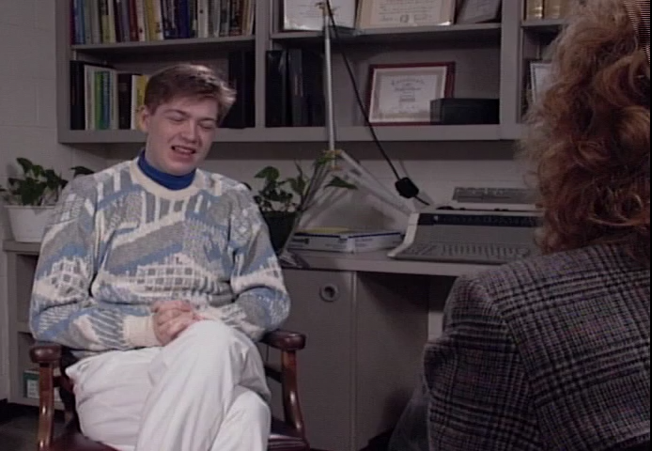
Judging a book by its cover?

Slide 7
Perpetrator “cover”
Religious cover
  Confessing smaller sins to appear honest
  Theological language
  Tears
  Gaining trust by talking about grace

Slide 8
Are you easy to fool?
I consider Church people easy to fool…they have a trust that comes from being Christians. They tend to be better folks all around and seem to want to believe in the good that exists in people. Because of that you can easily convince, with or without convincing words
Convicted perpetrator

Slide 9
Perpetrator “cover”
Religious cover
  Distorting biblical truth to coerce and silence victims

Slide 10
Perpetrator “cover”
Service cover
  Exploiting needs, exploiting vulnerable children

Slide 11
The pattern of exploitation
Testing
Desensitization
Isolation
Control

Slide 12
When caught?
Exaggerated hurt, self-referential
Well-rehearsed explanations
Accusations of others, you
Statistic to remember: 50-150!

Slide 13
2. Develop Prevention Policies
Assessment, Education, Limitation

Slide 14
Best prevention? Education
Educate the entire church!
  Start with scripture
  How abusers work
  Impact of abuse (victims and community)
  Necessity of lament in processing suffering
  Healing within a safe community
  Repentance, restitution as much as reconciliation

Slide 15
Define child abuse?
Any act or failure to act that causes non-accidental harm
  Physical and Psychological abuse
  Sexual abuse or exploitation
  Neglect

Slide 16
Sexual abuse?
What is sexual abuse?
  Rape; compelled rape
  Assault
  Exposure to sex acts; of genitals
  Molestation and incest
  Prostitution, sexual abuse or exploitation
Exposure to pornography? YES

Slide 17
Use case studies to educate
Troubled teen boy
  Known to be a liar and overdramatic
Tells you in private that elder in church is abusing him
  The elder is well known and respected by all
What should you do?

Slide 18
Case 2
Church member confesses to physical abuse of child
Feels guilty, wants help with anger
What do you do?

Slide 19
Prevention policies
Extensive interviews, background checks, references
  Would you hire this person?
Require training of all child workers
  Identifying signs of abuse
  Developing reporting procedures
  Connecting to local resources

Slide 20
Prevention policies
Set policies limiting one-on-one contact with children
Notify the church/organization of the reporting/response policies

Slide 21

Action Steps
Define background checks and abuse reporting procedures
Familiarize yourself with appropriate laws and agencies
  http://www.justice.gov.za/legislation/acts/2007-032.pdf
  http://www.justice.gov.za/vg/nrso.html

Slide 22
3. Recognize Poor Reactions
Why we sometimes fail to respond to abuse allegations

Slide 23
Revisiting case 1
Troubled teen boy
  Known to be a liar and overdramatic
Tells you in private that elder in church is abusing him
  The elder is well known and respected by all
What should you do?

Slide 24
Judith Hermann
It is very tempting to take the side of the perpetrator. All the perpetrator asks is that the bystander do nothing. He appeals to the universal desire to see, hear, and speak no evil. The victim, on the contrary, asks the bystander to share the burden of pain. The victim demands action, engagement, and remembering
Trauma and Recovery, p. 7

Slide 25
Which hurts more?
Wounds from an enemy?
or…
Neglect from a friend?

Slide 26
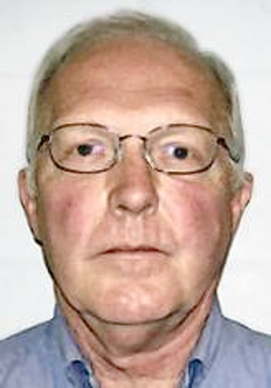

Individual reasons:
Winsomeness of abusive person
Denial and doubt
Self-protection

Slide 27
Group reasons:
Mistaken beliefs
Groupthink
System protection
Notes:
Ian Richardson (actor) in House of Cards, “When you will the end, you will the means.”

Slide 28
Additional poor responses
Rebuking the child/victim
Cover-up; half-truth
Silence

Slide 29
Additional reactions
Ignoring congregation and other victims
Focus on getting beyond the abuse
  Normalcy over ministry
Treating abuse as an isolated incident
  Ignoring systemic issues; ignoring the opportunity

Slide 30
4. Provide Pastoral Care To All
Spiritual Care Team Approach

Slide 31
When an allegation is made
Take allegations seriously
Report
Protect victim (and offender)
Allow officials to investigate
Choose truth as adornment over reputation
Provide pastoral care to all

Slide 32
Spiritual care team approach
Small group designed to pastor
  Contains both sexes
  Wise, able to listen and speak
Place for worship, self-evaluation, encouragement, and growth

Slide 33
The purpose of the SCT is…
Support and assistance [for] acute spiritual needs
Comfort, opportunity grow spiritually
To bring hope to those who are broken, disillusioned, and in need of restoration
From Wilson et al, Restoring the Fallen

Slide 34
The purpose of the SCT is…
Intercession and combined wisdom
Accountability, and direction
to Encourage the whole community

Slide 35
Prepare the SCTs
Spiritual work means warfare: Worship!
Group learning (biblical and experiential)
  Abuse, abuse of power, deception/denial, their impact on others, protection, true and false repentance, restoration, restitution, forgiveness, healing, etc.
  Restoration processes (time, process, fruit?)

Slide 36
Preparing for mercy ministry
Education
Abuse/impact
Abusers
Policy
Allegations
Prevention
Ministry
Victim/family
Offender/family
Community
Assessment

Slide 37
Planning for abuse crises
Define: values/goals
Educate: understand abuse and its impact
Build: policy and ministry teams
Assess: needs/fruit
Develop: mercy ministry trajectories for
  Victims (and their families)
  Offenders (and their families)
  The congregation

Slide 38
Define: values/goals
What do you want to undergird your work?
  Protection of the least of these (victim/offender)
  Mercy Ministry focus (vs. outcome)
    What would be considered a mercy?

Slide 39
Preparing for mercy ministry
Education
Abuse/impact
Offenders
Policy
Allegations
Prevention
Ministry
Victim/family
Offender/family
Community
Assessment
Regulations

Slide 40



Three important books
Langberg, D. On the Threshold of Hope
Salter, A. Predators: Pedophiles, rapists, and…
Schmutzer, A. The Long Journey Home

Slide 41
Preparing for mercy ministry
Education
Abuse/impact
Abusers
Policy
Allegations
Prevention
Ministry
Victim/family
Offender/family
Community
Assessment

Slide 42
Response policies
Who is in charge? Who manages details? Who knows the details?
What will happen once abuse is known?
  Reporting? Assessing? Communications? Ministry supervision?
  Special case for leader abuse?
  Do not make decisions in large-group settings!

Slide 43
Key assessments
Victims
  Spiritual needs of victims and family members
  Ongoing legal/civil stressors
Offenders
  Ongoing legal/civil/employment stressors
  Motivations of offender/family; Stated goals?
  Transparency? Caught? Confessed?

Slide 44
Preparing for mercy ministry
Education
Policy
Ministry
Victim/family
Offender/family
Community

Slide 45
Victim related interventions
Stabilize
  Address safety matters
  Prioritize the victim’s connection to worship
  Determine leadership oversight (don’t forget gender issues)
  Speak to attempts to lay partial blame on victim
Support
  Form small group of “listeners” who can support victim’s voice and therapy

Slide 46
Offender related interventions
Commitment focus
  Focus on big picture motivations and main truths
  Encourage action while pressure is on
  Validate small signs of repentance
Support
  Provide ongoing safe place for spiritual care for offender and family

Slide 47
SCT trajectory for restoration
Protection from self and others; boundaries set
Truth-telling about the abuse
Submission to process and acceptance of spiritual mentors
Discovery of roots of abuse and other sin (naming things from God’s view; hearing from others)
Notes:
Modifiable for victim’s needs too

Slide 48
SCT trajectory for restoration
Deeper Truth-telling about life patterns and God’s sanctifying work
Restitution (acknowledges injustice and seeks to correct it)
Repentance (from actions and attitudes)
Reconnection to the larger body of Christ
Notes:
Modifiable for victim’s needs too

Slide 49
Repentance
Signs of the real thing and imposters

Slide 50
Are those tears real?
What tells you that someone is repentant?
  Attitude?
  Accountability?
  Attention?
  Action?

Slide 51
The real test of repentance?
TIME and ______

Slide 52
Questions to ask yourself?
How do they respond to when others bring up their offenses?
How do they respond to accountability?
  Passivity is not always acceptance
  Do they chafe against the grace of restriction?
Are they growing in awareness of their impact? Of the roots and shoots?
Do they desire to restore losses to victims?

Slide 53
Imposters
Tears about self; about reputation
Shame (but not guilt)
Over-focus on feelings of forgiveness
Unwilling to wait to make public confessions
Confession only after being caught
Quid pro quo

Slide 54
Don’t forget
Hidden victims are watching!
Overwhelmed? That’s normal, but remember
  Isaiah 61:1-8

Slide 55
Helpful websites
http://www.netgrace.org. G.R.A.C.E (Godly Response to Abuse in the Christian Environment).
http://www.peaceandsafety.com. PASCH (Peace and Safety in the Christian Home)

Slide 56
Helpful articles & chapters
Langberg, D. (1996). Clergy sexual abuse. In Kroeger & Beck (eds) Women, abuse, and the Bible. Grand Rapids, MI: Baker Books.
Maxwell, J. (2006). Devastated by an affair: How churches heal after the pastor commits adultery. ChristianityToday. http://www.ctlibrary.com/39606.
Monroe, P. (2006). Abusers & true repentance. Christian Counseling Today, 13:3, 48-49.
Reed, E. (Winter, 2006). Restoring fallen pastors. Leadership Magazine. Found at: http://www.ctlibrary.com/le/2006/winter/22.21.html

Slide 57
It is Well with my Soul
When peace like a river attendeth my way, when sorrows like sea billows roll, whatever my lot, thou has taught me to say, “it is well, it is well with my soul.” (chorus)

Slide 58
It is Well with my Soul
Though Satan should buffet, though trials should come,
let this blest assurance control: That Christ has regarded my helpless estate, and has shed His own blood for my soul. (chorus)

Slide 59
It is Well with my Soul
My sin—O the bliss of this glorious thought, my sin—not in part but the whole, Is nailed to the cross and I bear it no more: praise the Lord, praise the Lord, O my soul. (chorus)

Slide 60
It is Well with my Soul
And, Lord, haste the day when my faith shall be sight, the clouds be rolled back as a scroll, the trump shall resound and the Lord shall descend: “Even so”—it is well with my soul. (chorus)

